Slide 1
Checklist for Abbott_TPP

Slide 2
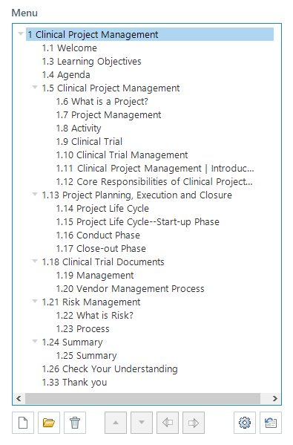
Menu:
Should be restricted on first visit
Menu should be arranged like the screenshot (for example) provided.
KC1,KC2, KC2….etc should be removed from menu.
Help should be removed from menu
Non-Interactive slides
Next button should be free.
Topic title
Page titles

Slide 3
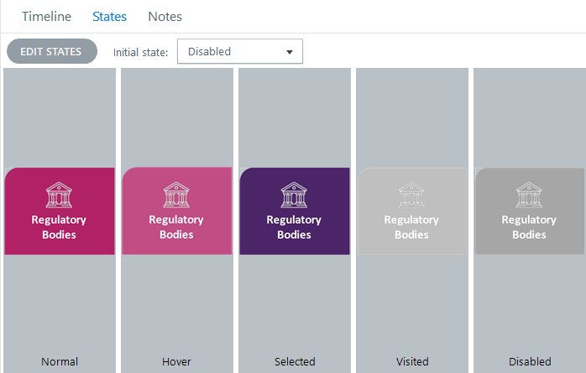
Interactive slides
Next button should be restricted on first attempt.
Next button should be free on revisiting a page using either the menu or the previous button.
All the tabs should be disabled at timeline start. It should enable (normal) at timeline ends.
Keep the states colors as mentioned below:
VO Artist
Use any Female voiceover

Slide 4
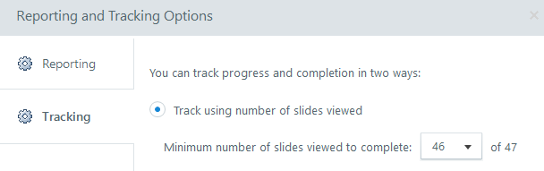
Knowledge checks (Present after each topic)
Functionality -
Keep shuffle answer option “off”
Next should not be there on KCs
Prev should jump to previous question
Clicking on “Continue” will jump to next question
Submit button should have 3 states – Normal, Hover, Disabled
Submit button should change to Disabled when feedback popup is opened.
Indicate the correct and incorrect answers using tick and cross marks, when the feedback popup opens.
Knowledge checks (Present at the end of the module)
Functionality -
Keep shuffle answers option “off”
Prev Next should not be there on KCs
Clicking on “Continue” will jump to next question
Submit button should have 3 states – Normal, Hover, Disabled
Submit button should change to Disabled when review feedback layer is opened.
Indicate the correct and incorrect answers using tick and cross marks, when the feedback popup opens.
Publish settings:
Tracking - on number of slides viewed (Total number of slides minus one)
Reporting - Complete/Incomplete
Keep format – HTML5 only

Slide 5
Design guidelines

Slide 6
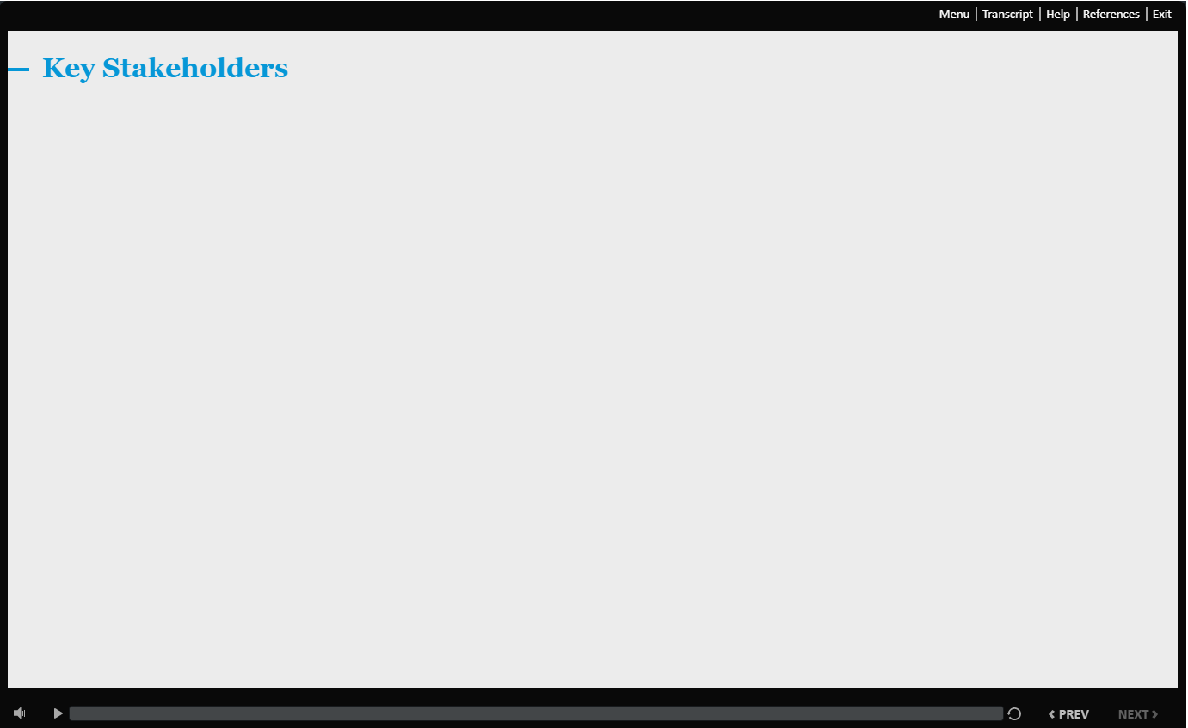
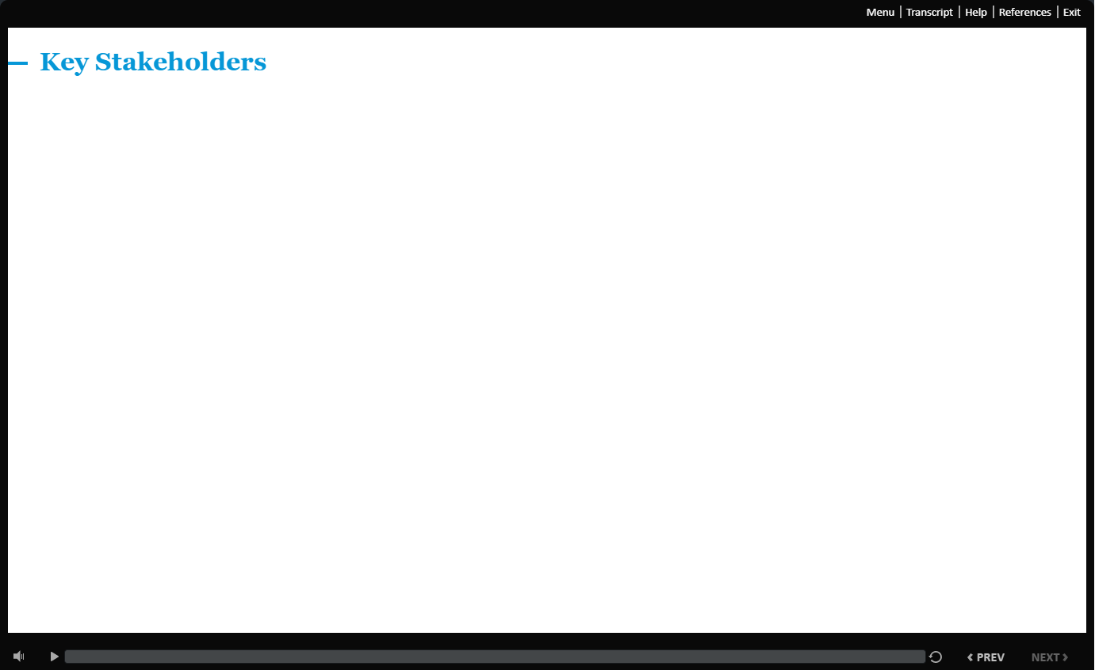
Page title
You can either use grey or white background as per your visualisation
GUI

Slide 7
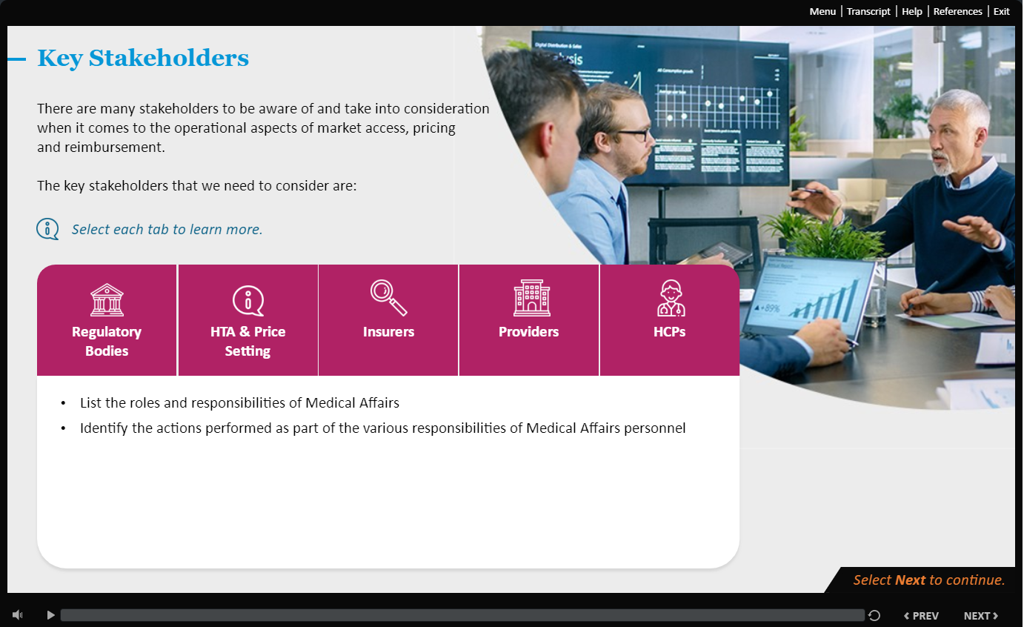
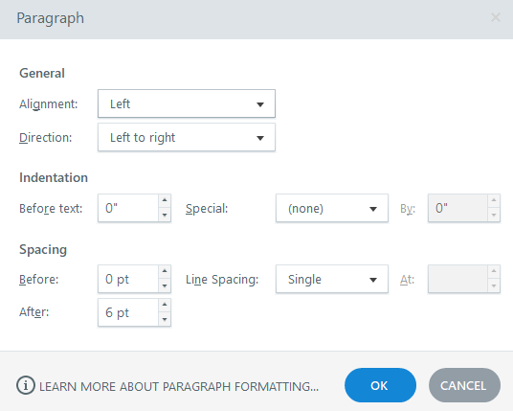
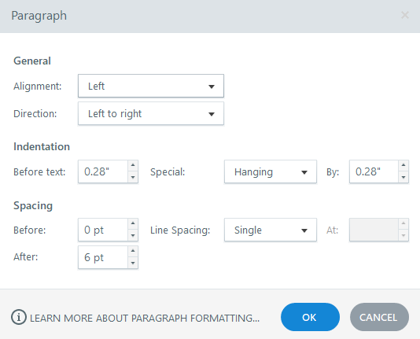
Georgia 24 (Bold)
Calibri 16
UI format:
Calibri 16 (Italic)
Icon style should be line icon only
Bullets formatting

Slide 8
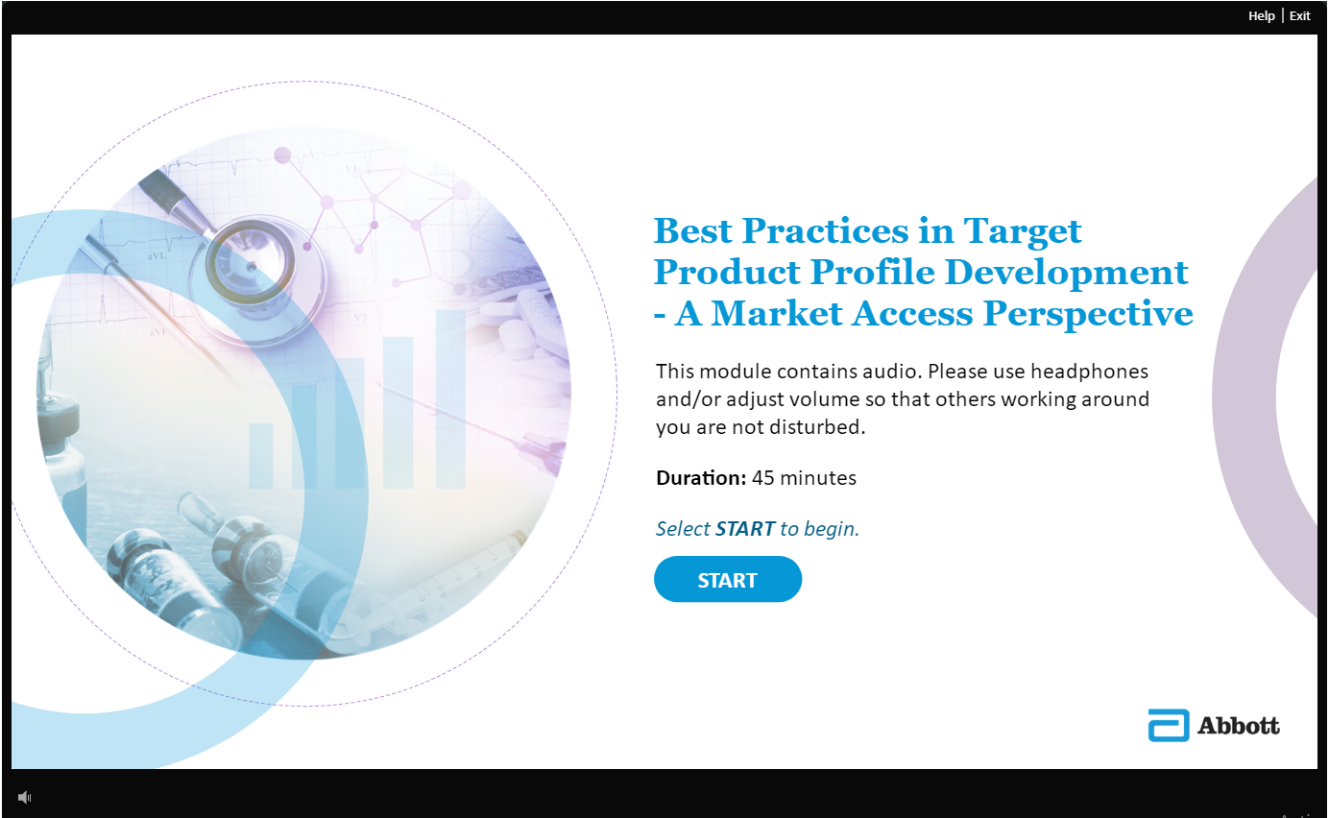
Please follow the rounded corners for squares, as we are following a rounded theme for this project

Slide 9
Mockups approved by Client

Slide 10
Welcome screen

Slide 11
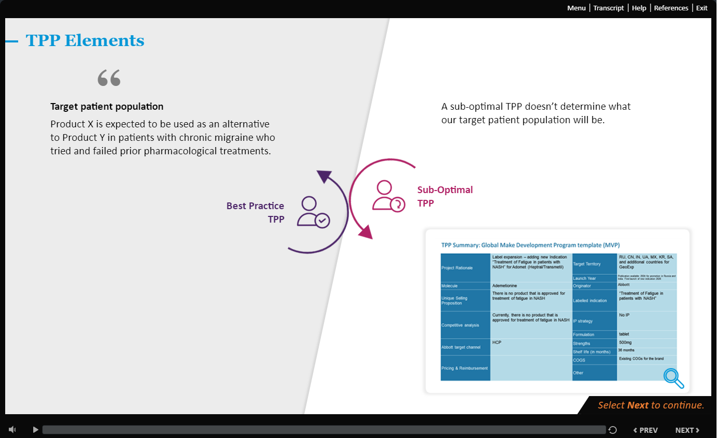
Non-Interactive screen

Slide 12
Interactive screen

Slide 13
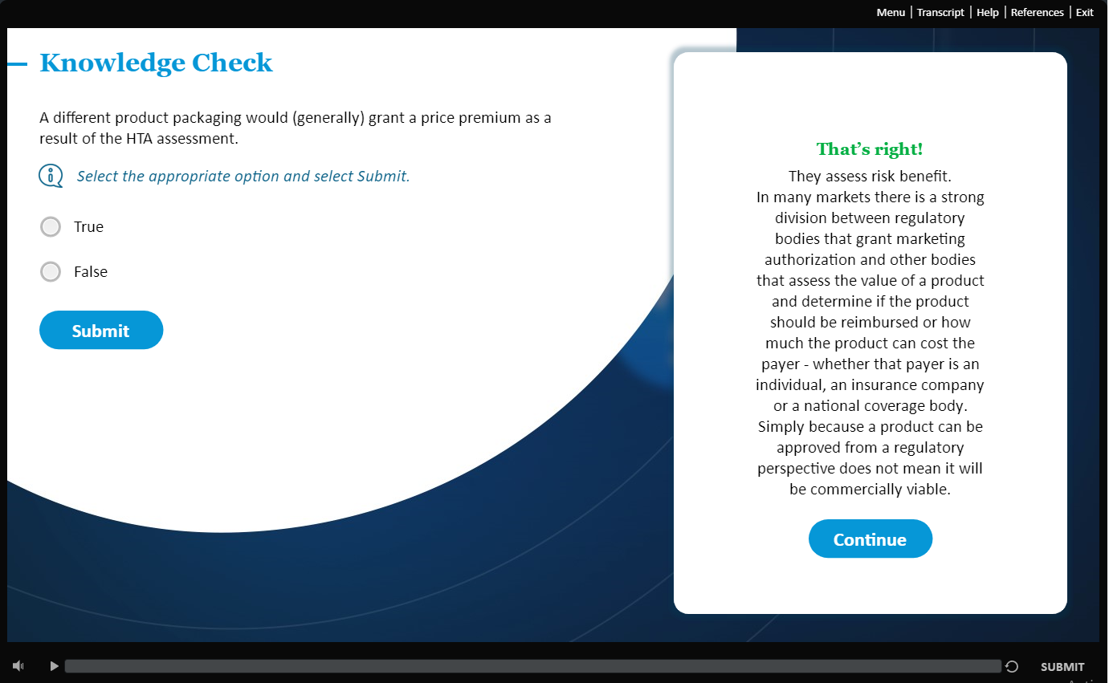
Knowledge check screen

